Slide 1
PHISHING URL DETECTION
-Project Designed By
Srihasa Vejendla
Mithilaesh Jayakumar

Slide 2
Data Set Description
.
The dataset set used in this project was obtained from two sources.
Legitimate URL : We can get a list of legitimate urls from the following link http://www.legitimate.com/?f
Phishing URL : We can get a list of Phishing urls from the following link https://www.phishtank.com/
The dataset file contains two columns one is the url itself and another is the class label indicating 0 if its legitimate or 1 if its phishing url.
The dataset contains “7498” - 0 label features and “6251” - 1 label features.

Slide 3
Balanced vs. Unbalanced Distribution
The dataset contains “7498” - 0 label features and “6251” - 1 label features which is an unbalanced distribution.
We balanced the dataset distribution using from sklearn.utils import resample. After resampling the dataset contains “6251” - 0 label features and “6251” - 1 label features.

Slide 4
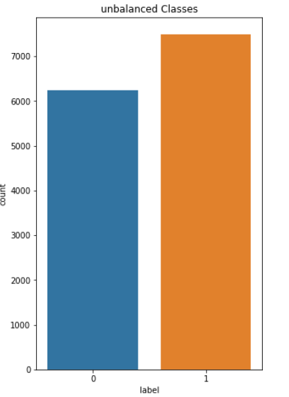
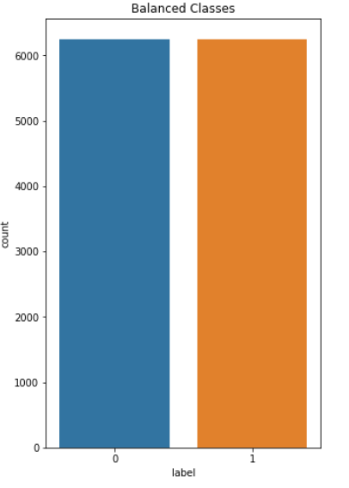

Slide 5
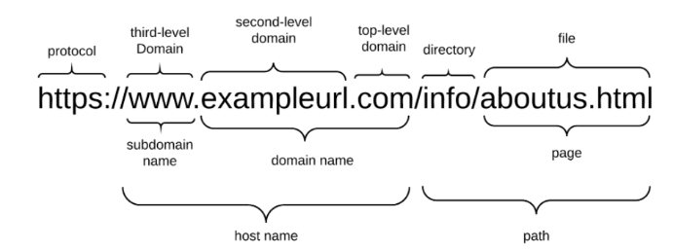
Feature Creation
The parts of a URL are:
The domain name portion is constrained since it has to be registered with a domain name Registrar.
A Host name consists of a subdomain name and a domain name.
A phisher has full control over the subdomain portions and can set any value to it.
The URL may also have a path and file components which, too, can be changed by the phisher at will.
The subdomain name and path are fully controllable by the phisher.

Slide 6
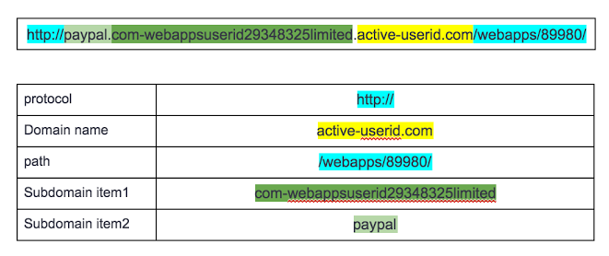
An example, although the real domain name is active-userid.com, the attacker tried to make the domain look like paypal.com by adding subdomain as PayPal.

Slide 7
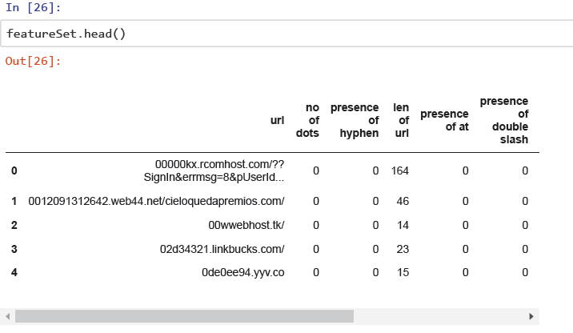
We calculate the no. of dots, presence of hyphen, length of url, presence of at, presence of double slash, no of subdir, no of subdomain, label etc. from a url which can be fed to the classifier for training.

Slide 8
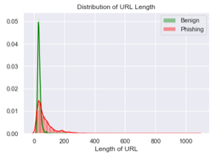
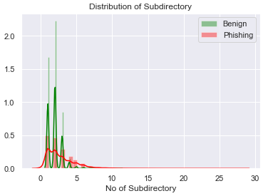
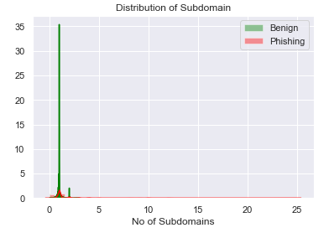
Visualization

Slide 9
Classification Models
Models
Decision Tree
AdaBoost
Logistic Regression
Gaussian NB
KNN
The dataset is split into train and test datasets in an 80:20 ratio.
The train dataset is used to train different classification models. The test data is used to finally evaluate the best among the models.

Slide 10
Tuning Hyper parameters
Models can have many hyper parameters and finding the best combination of parameters can be treated as a search problem.
We use GridSearchCV to find the best hyper parameters that can increase the accuracy for the same dataset.
Following are the hyper parameters which were tuned using GridSearchCV.
Decision Tree - Criterion, max_depth, splitter hyper parameters were tuned to find the best matching.
AdaBoost - learning_rate, n_estimators hyper parameters were tuned to find the best matching.
Logistic Regression - penalty, C hyper parameters were tuned to find the best matching.
KNN - n_neighbors, weights hyper parameters were tuned to find the best matching.

Slide 11
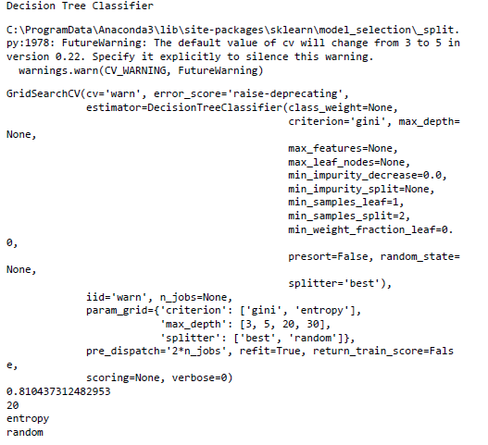
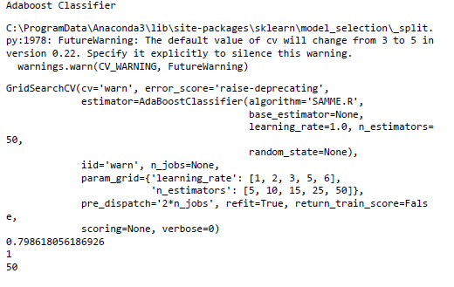

Slide 12
Accuracy Before and After Tuning
Classifiers | After tuning
Decision Tree | 0.81252
Logistic Regression | 0.769524
KNN | 0.793163
Classifiers | Before Tuning
Decision Tree | 0.807636
AdaBoost | 0.799636
Logistic Regression | 0.765455
Gaussian NB | 0.658545
KNN | 0.786545

Slide 13
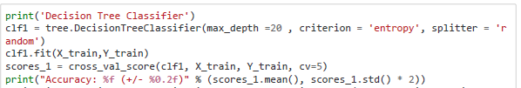

K-fold Cross Validation
We train the models on the tuned hyper parameters and use 5 fold cross validation for evaluating each model.
Using cross_val_score, the dataset is folded into 5 splits using cv attribute and we get the validation score for each fold.
The package is from sklearn.model_selection import cross_val_score.

Slide 14
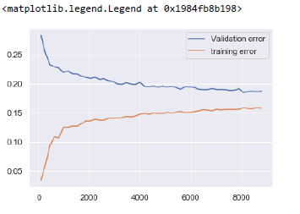
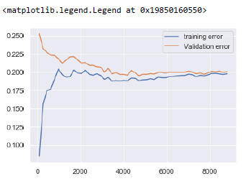
Learning Curves
We use learning curves to evaluate the performance of the different models during training and validation. We plot a curve between the training error and validation error which helps us to understand better about the bias and variance of the model.

Slide 15
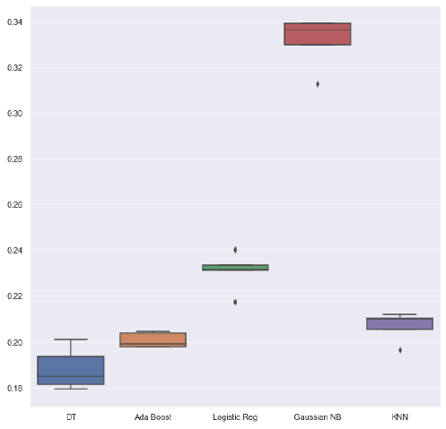
Error vs. Method
The below represents a boxplot of the errors obtained for each model after training on tuned hyper parameters.
The Decision tree model seems to have a reduced error which becomes our best selection.

Slide 16
Bias vs. Variance
From the learning curve we could see that the Decision Tree has a considerably more variance so we try to reduce the variance.
As there is a trade-off between variance and accuracy we try to reduce the variance without decreasing the accuracy.
A considerable decrease in the variance with the same accuracy was achieved in this case for the following hyper parameters.

Slide 17
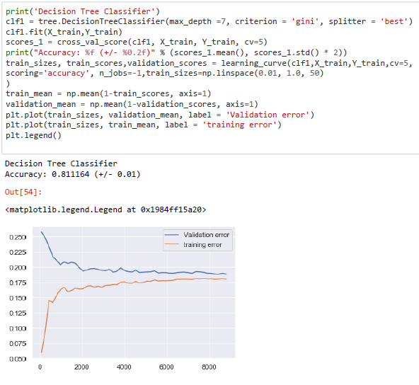
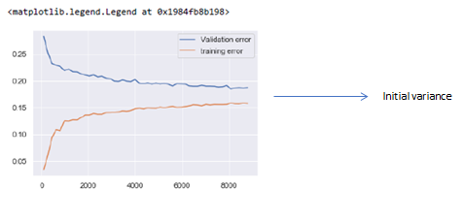


Slide 18
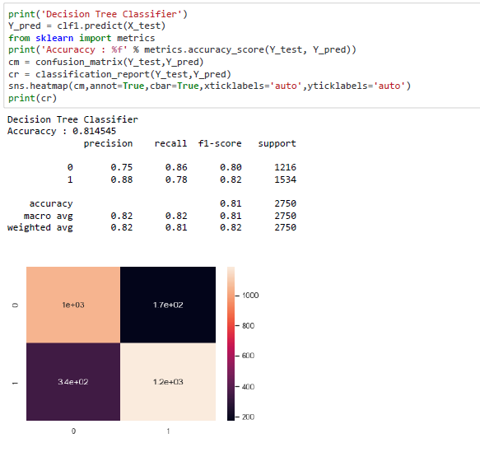
Performance Evaluation

Slide 19
Transfer Learning
The same trained Decision tree model was used to predict on another list of URLs and below were the accuracy achieved by the model.
This dataset contained 6500 URLs labelled as 0 or 1.
The same feature creation technique was used on these URL’s and prediction was made by the model on these obtained features.
When the model was exposed to new data set the accuracy increase compared to one obtained during testing because of considerable decrease in the variance.

Slide 20
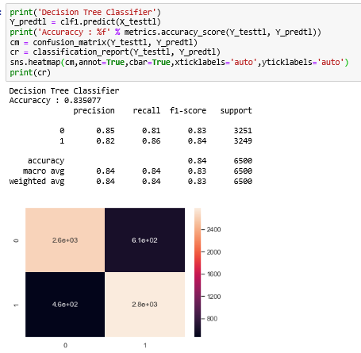

Slide 21
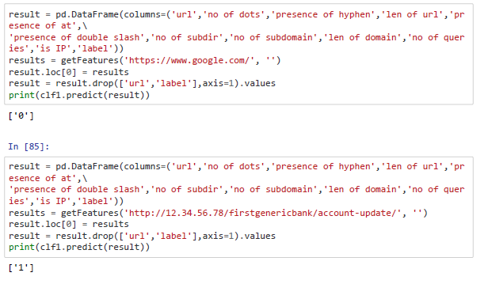
Demo

Slide 22
Conclusion
Models | Feedback
Decision Tree | The Decision tree works well for our dataset because the number of classes to predict is less (label 0/1). Also the performance of a decision tree increase with more number of training examples. As our dataset have more instances the accuracy is relatively high for this classifier.
Gaussian NB | The Gaussian NB did not work well on this dataset as the features created from the url are not independent and they are interlinked in predicting a class label (0/1)
Rest of the classifiers like Adaboost, Linear Regression and KNN have a considerably close accuracy.

Slide 23
Thank You

